Slide 1
Front-End Web Development Using React (ES6)
Front-End Web Development Using React – ES6
Eng. Reem Hassan Ahmed

Slide 2
01
ECMAScript versions
Front-End Web Development Using React – ES6

Slide 3
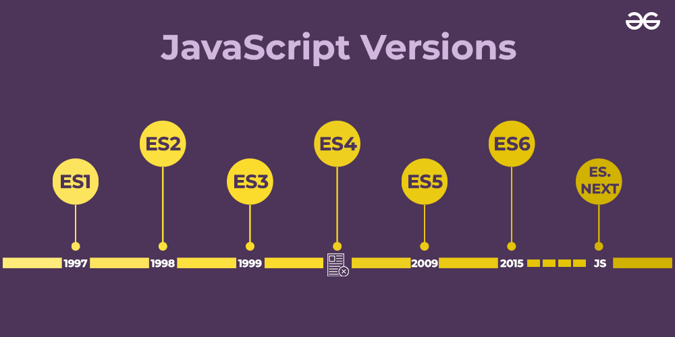
JavaScript Versions

Slide 4
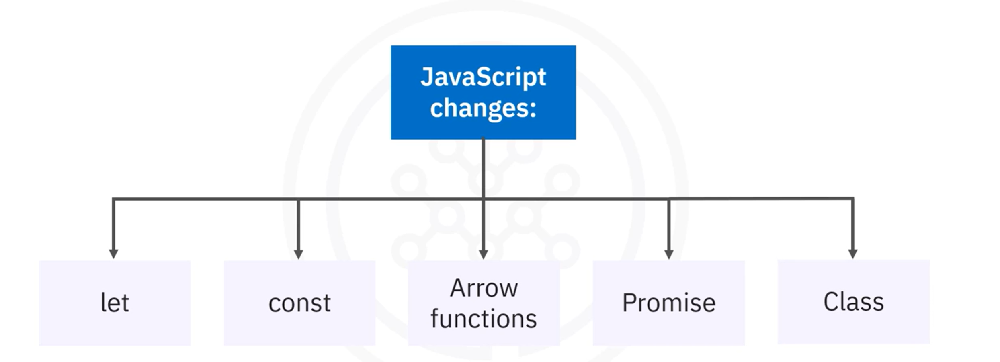
Es6 features

Slide 5
02
Hoisting
Front-End Web Development Using React – ES6

Slide 6
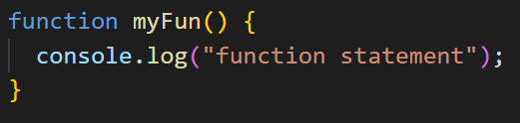
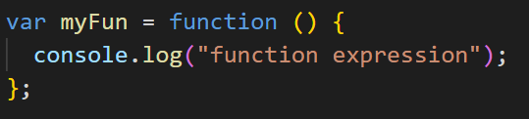
Hoisting
Function types:
Function statement → Hoisted
Function expression → Not hoisted
Function statement
Function expression

Slide 7
03
Block-Scope (let and const)
Front-End Web Development Using React – ES6

Slide 8
Block-Scope (let and const)
Let and const:
The let keyword allows you to declare a variable with block scope.
The const keyword allows you to declare a constant (a JavaScript variable with a constant value).
Constants are similar to let variables, except that the value cannot be changed.
Let and const characteristics:
Not hoisted
Block scope
Cannot declare a variable with the same name using let or const or var within the same scope

Slide 9
04
String literals
Front-End Web Development Using React – HTML

Slide 10
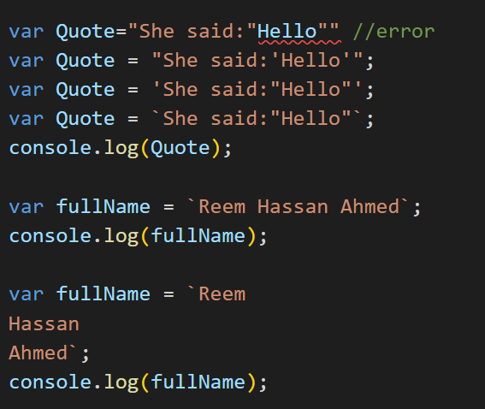
String literals (backticks)

Slide 11
05
Spread and rest operators
Front-End Web Development Using React – ES6

Slide 12
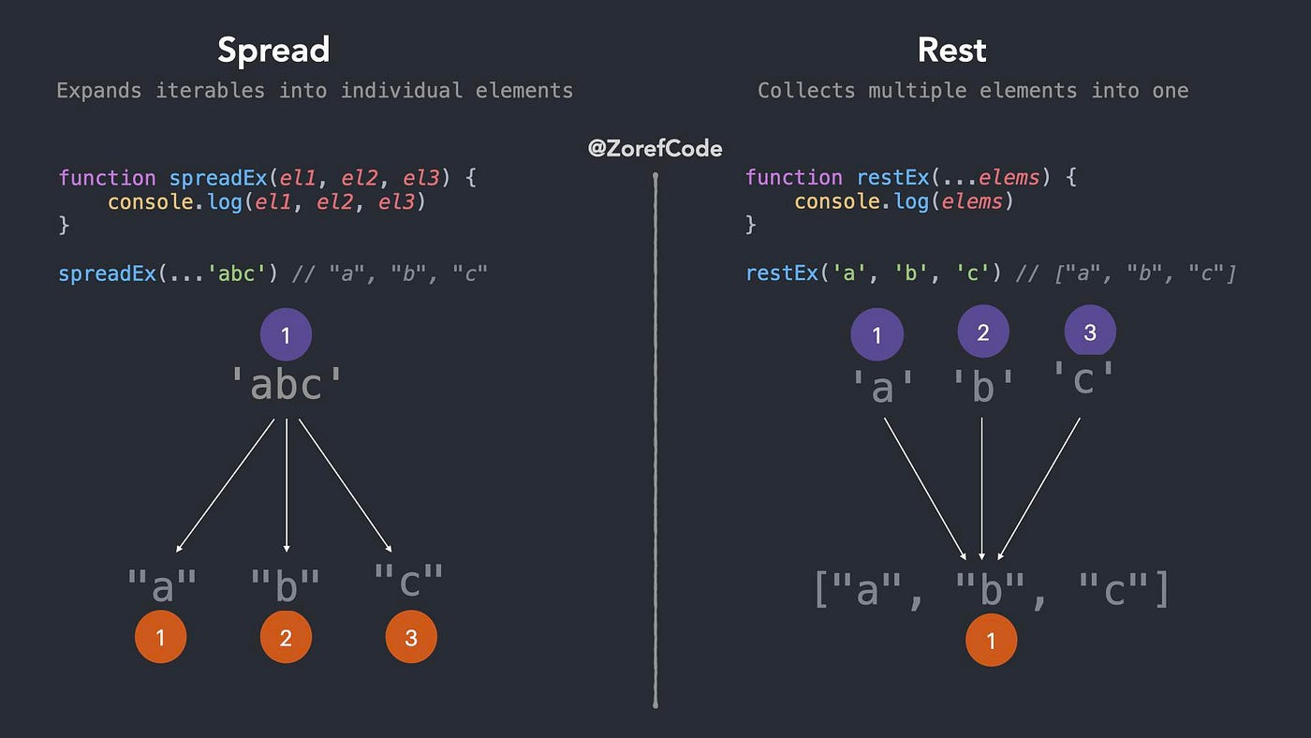
Rest operator
The operator (…) is used as rest operator and as spread operator.
1- Rest
Rest operator takes number of values and represents an array containing these values.
It is used as rest operator in the function declaration as parameters (Destructing).
Function cannot have more than one rest operator.
It must appear at last position in the parameter list.

Slide 13
Spread operator
The operator (…) is used as rest operator and as spread operator.
2- Spread
Spread operator takes and array and returns its values separated.

Slide 14
06
Arrow functions
Front-End Web Development Using React – ES6

Slide 15
Arrow function
Arrow function characteristics:
Must be declared as a function expression.
Not hoisted.

Slide 16
Thanks!
Front-End Web Development Using React – HTML
Does anyone have any question?
ReemHassan160299@gmail.com
+201092427577

